Slide 1

Understand Best In Town

Slide 2

What Is the Meaning of Best In Town?
In a world of accelerating change, customers have come to expect best experiences that benefit them in unique ways.
Akio Toyoda’s vision for all Toyota Regions and Distributors is to operate in this way, by continuously and quickly evolving to meet customer expectations. Simply said, this is the Best in Town mindset.
Akio Toyota Video Explaining Best in town Philosophy during U.S. dealer visit to his restaurant in Japan
Click To watch the Video
https://youtu.be/Tg1uP9uSdOw

Slide 3
As you watch the video, you should note a few important aspects of being Best in Town:
Best in Town is unique to your Distributor and/or Dealerships because expectations within each market and town are unique.
Best in Town requires a focus on the one-by-one experience for each customer.
Being Best in Town is not “best automotive experience in town” but “best experience in town”; therefore, you should benchmark against all other experiences (hotels, restaurants, retail stores, and other automotive Distributors and Dealerships).

Slide 4



















MEBIT OVERALL
What is Middle east Best In Town (MEBIT) ?
Dist
Kaizen
(Improvement)
Distributor works
MEBIT is a Program Designed by TMC to support MECAD Distributors.
1st Workshop Started in August 2019. Where the Aim is to Provide Support Educational Programs and Best Practices.
Main Agenda of MEBIT Programs is
Promote Kaizen Mindset
HRD
Toyota Business foundation ( TW,TPS,TBP)
Share best Practices
Start Activities in MECA Region.
SOP
TMC Support
TBP
(Toyota Business
Practices)
Dist
Dist
MEBIT W/S
(Good Practices Sharing
& TBP follow up)
BENEFIT
TBP
Training
SGA
(Small Group
Activity)
Good
Practices
Continuous Profit
Customer Satisfaction
Customer Delight
Employees Satisfaction
Kaizen Culture
Absorption
Toyota Fan
MEBIT
Portal Site
GOODs and Information Flow(GIF)
Obeya
India
Trip
Dist
Work
Shop
Dist
Human Resource
Development
Notes:
This slide shows the overall image of our best in town activity.
Our goal is to maximize customers’ satisfaction and customers’ delight as you can see the right side of this slide.
When we can achieve it, the profit will follow.
To achieve this goal, we need to continuously turn the gear of Kaizen as you see the upper side of the slide.
But it’s not easy to turn the Kaizen gear by itself.
Supporting gears such as good practices, small group activity, and TBP as you see in the middle of the slide,
will help turn the kaizen gear more smoothly.
In particular, we believe TBP, focusing on the problem solving way is essential to realize better Gemba, branch, retailer operations.
And needless to say, Human Resource Development is an imperative foundation for Kaizen activities.

Slide 5

Our challenge
Continuously increase our profit by improving customer satisfaction through “customer first” activity
Notes:
Our challenge is to continuously increase our profit by improving customer satisfaction through customer first activity.

Slide 6
Ideal Situation
How Efficiently the Dealership is recovering its cost ?
Absorption ratio > 100%
Total Revenue except New Car
_______________________
=
100% & More
Total FIX Expenses
>> Completely enjoy new car sales profit
Notes:
Ideally speaking, absorption ratio should be over 100% by branches.
This means Aftersales revenue can cover all the expenses in a branch.
If you realize this situation, you can completely enjoy your new car sales profit without spending for costs.

Slide 7


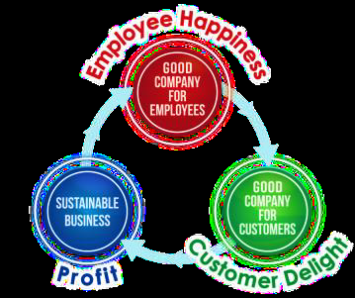
Ultimate goal of BIT
1. To REALIZE A WORLD that all personnel from staff level to management, at our sales and service outlets, share strong KAIZEN MINDS and are able to conduct Kaizen activities AUTONOMOUSLY.
Customer Satisfaction
never exceed Employee Satisfaction
EMPLOYEE ENGAGEMENT
$
PROFIT
CUSTOMER
DELIGHT
Notes:
First, to realize a world that all personnel from staff level to management, at our sales and service outlets, share strong Kaizen minds and are able to conduct Kaizen activities autonomously.

Slide 8


Ultimate goal of BIT
2. The SOPs will keep on improving and keep on evolving based on the Kaizen activities conducted at each outlet.
Listen to Customer voice
⇒ Reflect into Actual Operation
Notes:
Second, the SOPs will keep on improving and keep on evolving based on the Kaizen activities conducted at each outlet.

Slide 9
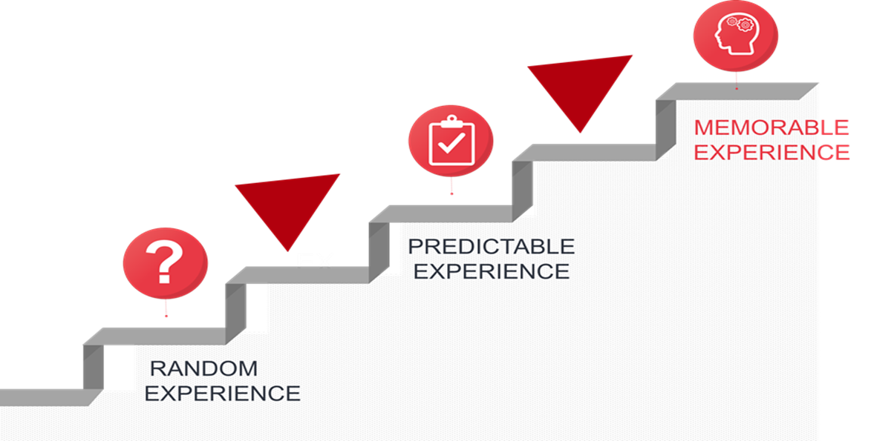

Ultimate goal of BIT
3. As a result, we’ll continue to realize the MOST EFFICIENT sales and service operations and will be able to deliver the BEST CUSTOMER EXPERIENCE, by far, making respective sales and service outlets BEST IN TOWN.
Notes:
Third, as a result, we’ll continue to realize the most efficient sales and service operations and will be able to deliver the best customer experience by far, making respective sales and service outlets best in town.

